Slide 1
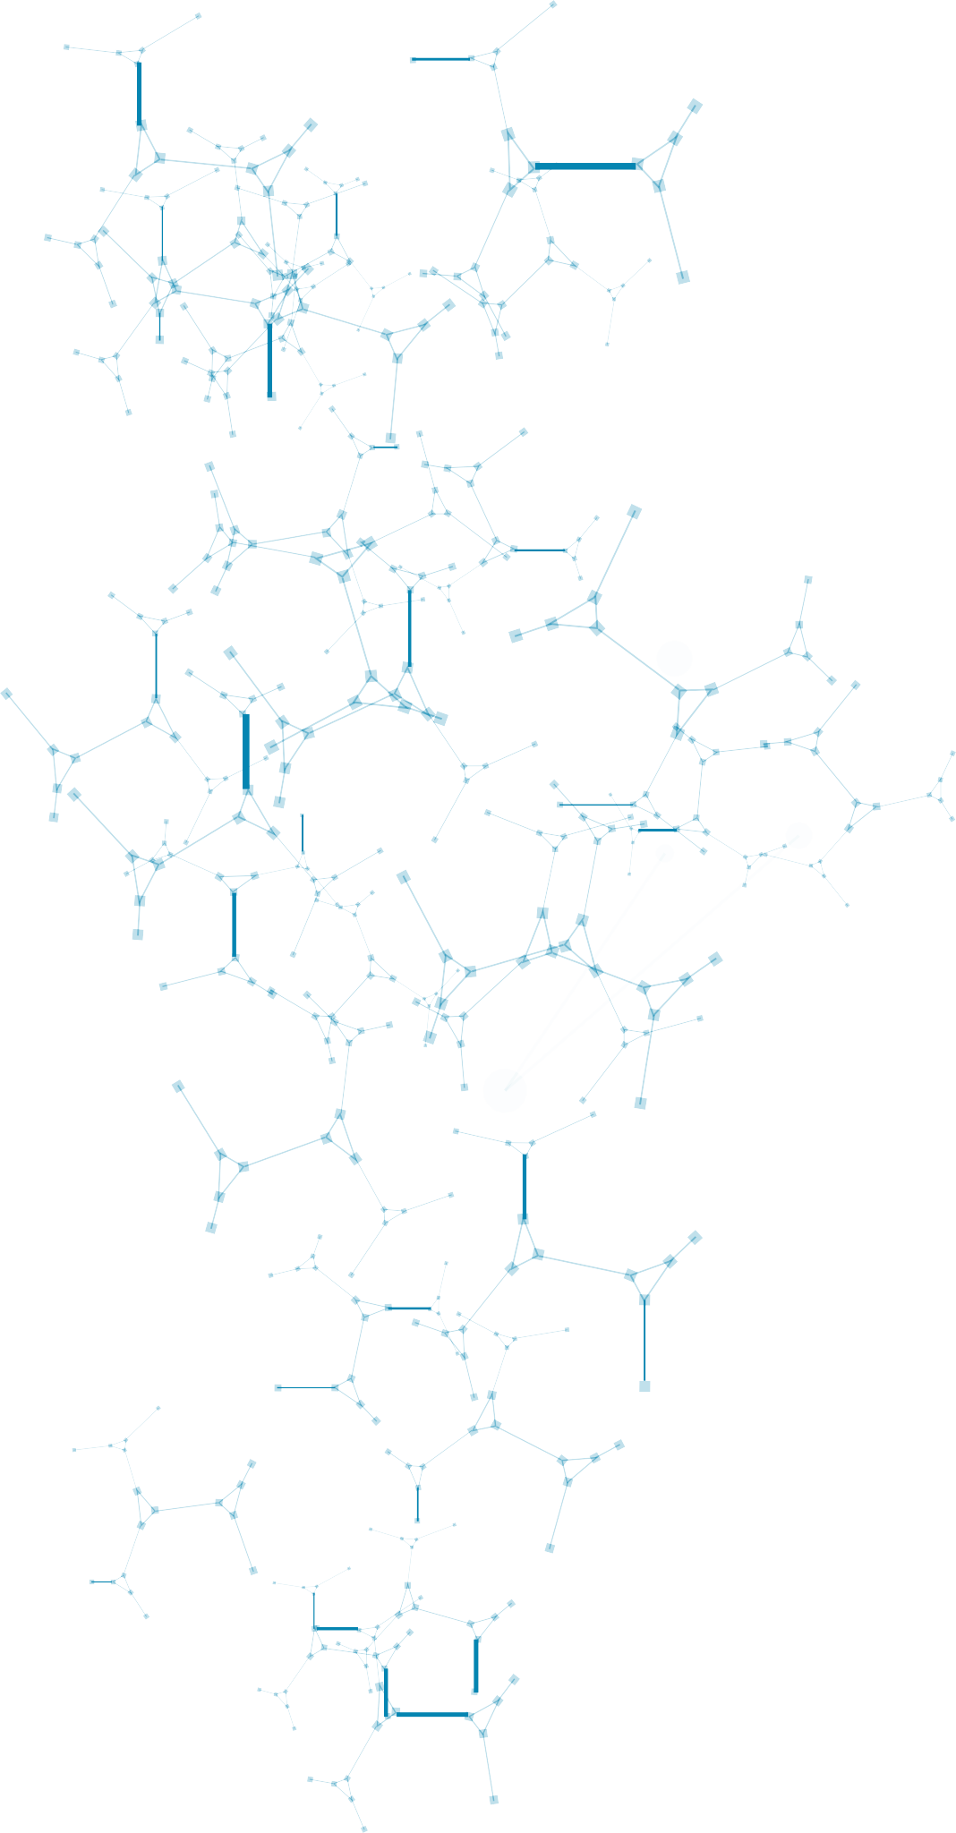















TRADE ENTERPRISES CHARACTERISTICS: COSTA RICAN EXPERIENCE

Slide 2

















DEI: How it works?
1
ITR
Distribution (establishment)
Connector
(Tariff heading)
QlikView
Data connection
2
Enterprise´s
ID
Sources
REVEC
3
D-151
Distribution (whosalers/ retailers)
Goods belonging to a non residents
Worksheet (Excel)

Slide 3





1 International Trade Register (ITR)

Slide 4


2 Economic Variables Register (REVEC)
Variables

Slide 5






3 Taxes (D-151)
ID reporter and ID reported
Identification
D-151
Amount of transactions
How much? Whom?
ID
Sales Purchases Professional Services Rentals Commissions Interest
Detailed

Slide 6

Linking data sources
Customs
Traded product is assigned to the corresponding economic activity (correspondance tables)
Economic variables
Enterprise´s ID
(Key)
Standard Economic Activities of Costa Rica (EACR)
ISIC Rev.4
Employment-Salary
Revenues
Type of ownership
D-151
Output: datasets
Who to whom transactions
Classify wholesalers and retailers sales by economic activity
Estimate final consumption and gross capital formation

Slide 7





















Datasets
Trade by
Type of
Others
Economic activity and enterprise size class
Trader
Concentration of trade by activity
Two way trader
Commodity and activity
Ownership
Partner country and activity
Partner country and size class
Number or partner country and activity
Export/import intensity
Activity industry

Slide 8




















































































































































































































Resulting process: export-import process
Exporter/Importer ID Partner Country FOB value $/¢
CIF value $/¢ Weight Taxes
Encoded customs
Customs informations is matched with
Start
Customs information
Report
End
information
REVEC
According to heading tariff (HS 2012)
-CPC2
-BEC
-ISIC4
-SPC-CR
Trade by:
-Activity industry
-Enterprise size class
-Partner country
-Activity
-Commodity
-Type of trader and ownership
-Concentration of
trade by activity
-Export/ import intensity
-Import matrix
SPC-CR: Costa Rica´s Standard Product Classification REVEC: Economic Variables Register
Source: Central Bank of Costa Rica.

Slide 9


Resulting process: import matrix process
Intermediate consumption
Products (NP) |  | Industries (EA) | Total
 |  | Agriculture Manufacture Construction Trade Hotel Financial Other transportation services services
Agriculture |  | Imported products for intermediate consumption (c.i.f values)
Manufacture
Construction
Trade
Hotel and transportat | ion
Financial services
Other services
Total (basic prices) |  | Intermediate consumption economic activity | Imported intermediates
Source: Based on SNA2008 and Manual of Supply Use and Input-Output Table, Eurostat.

Slide 10
Resulting process: import matrix process
Final consumption
Products (NP) |  | Categories | Total
 |  | Expenditure Expenditure Expenditure Gross fixed Changes by households by non profit by goverment capital inventories organisations formation
Agriculture |  | Imported products for final consumption (c.i.f values)
Manufacture
Construction
Trade
Hotel and transportat | ion
Financial services
Other services
Total (basic prices) |  | Final uses by category | Imported final uses
Source: Based on SNA2008 and Manual of Supply Use and Input-Output Table, Eurostat.

Slide 11

























































































































































































Resulting process: import matrix process
According to heading tariff (HS 2012)
-CPC2
-BEC
-ISIC4
-SPC-CR
Encoded
Customs informations is
Assign Economic Activity
Has the company several establishment
Yes
Assign the most
appropiate EA
Start
Customs information
customs
matched with REVEC
information
Yes
Sales structure D-151
Encoded
Customs informations is matched with REVEC
Retailer or whosaler?
customs
information
No
Small values imported by household for their
own use
Intermediate consumption by EA
Final comsumption
Gross formation capital fixed
Generating import matrix
SPC-CR: Costa Rica´s Standard Product Classification REVEC: Economic Variables Register
D-151: Intercompany declarations of purchases and sales
Source: Central Bank of Costa Rica.
End
11

Slide 12



Main statistical results
Concentration of exports value, 2019
Top 5
Top 10
Top 50
22%
31%
55%
12

Slide 13


Main statistical results
Exports value according to number of partner countries, 2019
15-19
partner
20
partner
20%
29%
13

Slide 14





The way ahead
To incorporate improvements in DEI software in order to streamline the process.
Add exports by partner country to the system because services comprise over 40% of all exports in Costa Rica.
Add in the information per company the value added when available.
Add inventories and other information form Income Tax Return data (D-101 form of Ministry of Finance) declaration.
14

Slide 15

TRADE ENTERPRISES CHARACTERISTICS: COSTA RICAN EXPERIENCE

